Slide 1

Theerawut Thaweephattharawong
Software Testing

Slide 2
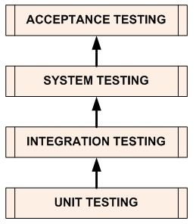
Software Testing Levels
Unit Testing | A level of the software testing process where individual units of a software are tested. The purpose is to validate that each unit of the software performs as designed.
Integration Testing | A level of the software testing process where individual units are combined and tested as a group. The purpose of this level of testing is to expose faults in the interaction between integrated units.
http://softwaretestingfundamentals.com/software-testing-levels/

Slide 3
Software Testing Levels
System Testing | A level of the software testing process where a complete, integrated system is tested. The purpose of this test is to evaluate the system’s compliance with the specified requirements.
Acceptance Testing | A level of the software testing process where a system is tested for acceptability. The purpose of this test is to evaluate the system’s compliance with the business requirements and assess whether it is acceptable for delivery.
http://softwaretestingfundamentals.com/software-testing-levels/

Slide 4
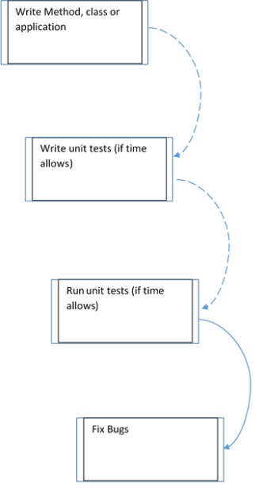
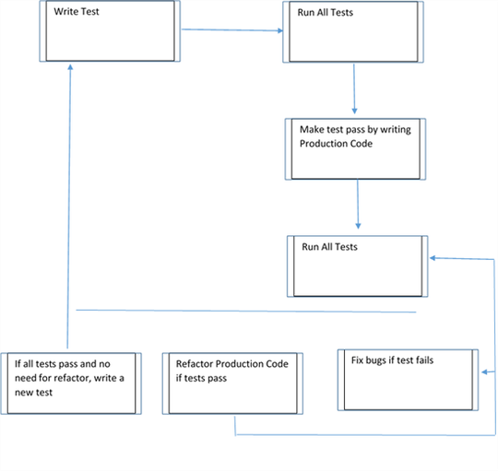
Unit Testing
Test Driven Development (TDD.)

Slide 5
ด้วย NUnit Framework

